Slide 1

Maya MEL — Advanced
Part 2
Getting The Most From MEL

Slide 2

Welcome!
  MEL vs. C/C++
  Pure3D, MEL and You
  Scripting techniques
  Advanced UI techniques

Slide 3
vs. C: MEL's Limitations
  NO array of arrays
  NO variable argument lists
  NO overloaded functions
  NO pointers
  NO pass-by-reference (except arrays)
  NO dynamically allocated matrices
  NO binary file output
  NO component selection order (!)
  NO debugger (stack trace)

Slide 4
vs. C: MEL's Advantages
  Interpreted – Immediate results
  Arrays are passed by reference
  Arrays allocate themselves
  Auto variable typing (use sparingly!)
  Auto datatype conversion
  Undo/Redo included for free
  vs. Maya SDK
  UI must be written in MEL
  Maya construction tools only in MEL

Slide 5
MEL vs. C
  No (bool) datatype
    Typically use (int)
    Any non-zero value is TRUE
  All floating point uses (float)
    Range of (double)
    Internal accuracy to ~15 decimal places
    Represented accuracy only ~6 decimal places
  Tip: Assign (float) query to (string)
  datatype.

Slide 6

How Pure3D Uses MEL
Find transform/shape relationships
Navigate up- and downstream
Find nodes of a specific type
Convert one selection type to another
Manage shading assignments

Slide 7
How Pure3D Abuses MEL
Override or replace Maya scripts
Add shelf layouts and buttons
Add menus
React to user
Manage display layers
Generate Attribute Editor layouts
Custom UI

Slide 8

Maya's Shelf
Pure3D plug-ins create their own Shelf
Global string identifies shelf UI
global string $gShelfTopLevel
This is NOT a shelfLayout!
Add your new shelfLayout to Maya's tabLayout

Slide 9
Maya's Shelf
// Maya's global Shelf
global string $gShelfTopLevel;
// Create a new Shelf
shelfLayout -parent $gShelfTopLevel
ShelfName;
// Create a button on the Shelf
shelfButton -image1 "sphere.xpm"
-command "sphere";

Slide 10
Maya's Shelf
Convenience script command:
// Create a new Shelf
addNewShelfTab "ShelfName";

Slide 11
Maya's Shelf
MEL How-To:
How do I create and edit Shelf buttons?
http://ewertb.com/maya/mel/mel_a30.html

Slide 12
Maya's Menus
Adding a menu to Maya's menu bar
global string $gMainWindow;
setParent $gMainWindow;
menu -label "My Menu";

Slide 13
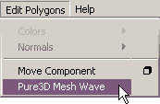
Maya's Menus
p3dMeshWave in Edit Polygons menu
string $menus[] = `lsUI -type "menu"`;
string $label = `menu -q -label $menu`;
if ( $label == "Edit Polygons" ) {}

Slide 14
Maya's Menus
string $items[] =
`menu -q -itemArray $menu`;
if ( `menuItem -q -label $item` ==
"Pure3D Mesh Wave" )
{ /* already installed */ }
setParent -menu $menu;
menuItem -label "Pure3D Mesh Wave"
-c "p3dMeshWave";

Slide 15
Maya's Menus
Caution! Menus are built dynamically!
string $menuItems[] =
`menu -q –itemArray $menu`;
if ( size( $menuItems ) == 0 ) {
// Populate with postMenuCommand.
string $pmc = `menu -q -pmc $menu`;
eval $pmc;
$menuItems = `menu -q -ia $menu`;
}

Slide 16
Maya's Menus
Globals identify menus for Maya modes:
global string $gModelingMenus[6];
global string $gAnimationMenus[6];
global string $gDynamicsMenus[7];
global string $gRenderingMenus[4];
global string $gClothMenus[3];
global string $gLiveMenus[5];

Slide 17
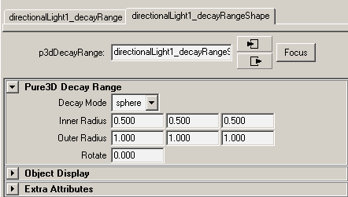
Attribute Editor Templates
Definition script:
AE<nodeType>Template.mel
AEp3dDecayRangeTemplate.mel

Slide 18
Attribute Editor Templates
The editorTemplate command
global proc AEp3dDecayRangeTemplate( string $node ) {
editorTemplate -beginScrollLayout;
editorTemplate -beginLayout "Pure3D Decay Range";
editorTemplate -addControl "decayMode";
editorTemplate -addControl "innerRadius";
editorTemplate -addControl "outerRadius";
editorTemplate -label "Rotate"
-addControl "rotateY";
editorTemplate -endLayout;
editorTemplate -addExtraControls;
editorTemplate -endScrollLayout;
}

Slide 19
Attribute Editor Templates
Use -suppress flag to hide attributes
editorTemplate -suppress "intermediateObject";
editorTemplate -suppress "caching";
editorTemplate -suppress "nodeState";
editorTemplate -suppress "useObjectColor";
editorTemplate -suppress "objectColor";
editorTemplate -suppress "drawOverride";
editorTemplate -suppress "lodVisibility";
editorTemplate -suppress "renderInfo";
editorTemplate -suppress "motionBlur";
editorTemplate -suppress "visibleInReflections";
editorTemplate -suppress "visibleInRefractions";
editorTemplate -suppress "castsShadows";
editorTemplate -suppress "receiveShadows";

Slide 20
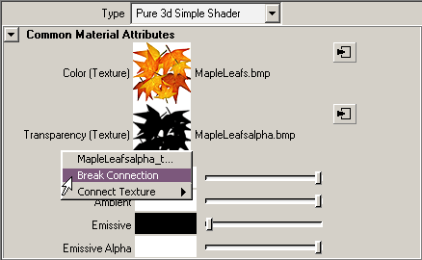
Attribute Editor Templates
Use -callCustom to "roll your own"
editorTemplate -callCustom AEshaderTextureNew
AEshaderTextureReplace "color";
editorTemplate -callCustom AEshaderTextureNew
AEshaderTextureReplace "transparency";

Slide 21
Display Layers
Creating a displayLayer
createDisplayLayer
-name "myDisplayLayer" -empty;
Querying members of a displayLayer
editDisplayLayerMembers -q myDisplayLayer;
Adding members to a displayLayer
editDisplayLayerMembers myDisplayLayer
pCube1 pSphere1;

Slide 22
React to the User
scriptJob
n. A callback triggered on a Maya event.
41 event triggers:
  SceneOpened
  SelectionChanged
  timeChanged
  ToolChanged
Do not use idle event!

Slide 23
React to the User
scriptJob -event "SelectionChanged"
"P3DBoundingTools_SelectProc"
scriptJob -attributeChange $scaleAttr
$cmd;
scriptJob -event "NewSceneOpened"
"arp_TrashDopeUI()"
scriptJob -parent $parent
-event "SceneOpened" "P3DUpdateExportSettingsGUI;

Slide 24
React to the User
"NewSceneOpened"
  Event triggered on File -> Open and File -> New
"SceneOpened"
  Event triggered only on File -> Open

Slide 25
React to the User
Parent the scriptJob to a control if it is exclusive to a particular UI.
window myToolWindow
/* … */
scriptJob -parent myToolWindow
-event "SelectionChanged" "myToolEventCB"
showWindow myToolWindow

Slide 26
getTransform()
proc string getTransform( string $shape ) {
string $transform = $shape;
// Skip if node is already a transform
if ( `objExists $shape` &&
( "transform" != `nodeType $shape` ) &&
// Special case for "joint"
( "joint" != `nodeType $shape` ) )
{
string $parents[] =
`listRelatives -fullPath -parent $shape`;
$transform = $parents[0];
}
return $transform;
}

Slide 27
getShape()
proc string getShape( string $xform ) {
string $shapes[];
$shapes[0] = $xform;
string $isTransform[] = `ls -transforms $xform`;
// If not a transform, assume it is a shape
if ( `size $isTransform` > 0 )
{
$shapes =
`listRelatives -fullPath -shapes $xform`;
}
return $shapes[0];
}

Slide 28
listConnections
Traverse the Dependency Graph network

Slide 29
listConnections
listConnections brow_mad;
// isc_facial_rig brow_mad_state brow_mad brow_mad //
listConnections -destination false brow_mad;
// brow_mad_state brow_mad //
listConnections -d false -connections true brow_mad;
// brow_mad.state brow_mad_state
brow_mad.weight brow_mad //
listConnections -d false -c true -plugs true brow_mad;
// brow_mad.state brow_mad_state.output
brow_mad.weight brow_mad.state //

Slide 30
Node Types
Determine a node's type: nodeType
nodeType persp;
// Result: transform //
nodeType perspShape;
// Result: camera //
nodeType polySurfaceShape1;
// Result: mesh //
nodeType brow_mad;
// Result: p3dDeformExpressionState //
objectType is not recommended.

Slide 31
Node Types
Get a list of a specific node type:
ls -lights;
// Result: directionalLightShape1 //
ls -type "mesh";
// Result: L_eyeShape L_knee_PVShape Orientation_RootShape R_ankle_conShape R_eyeShape R_knee_PVShape //
ls -type "p3dDeformExpressionState";
// Result: brow_mad brow_sad brow_sarL brows_up eyes_blink eyes_squint //

Slide 32
Intermediate Meshes
Be alert for Intermediate Meshes:
ls -type "mesh";
// polySurfaceShape2 polySurfaceShape2Orig //
getAttr polySurfaceShape2.intermediateObject;
// Result: 0 //
getAttr polySurfaceShape2Orig.intermediateObject;
// Result: 1 //
ls -noIntermediate -type "mesh";
// Result: polySurfaceShape2 //

Slide 33
Filtering Using 'ls'
Use 'ls' flags to filter selection items:
ls -sl -type "mesh";
// polySurfaceShape2 //
string $nodes[] = {
"polySurfaceShape2",
"polySurfaceShape2Orig" };
ls -noIntermediate $nodes;
// Result: polySurfaceShape2 //

Slide 34
Managing Component Selection
Expand component selection:
ls -sl;
// Result: pSphere1.f[28] pSphere1.vtx[27:29] //
ls -sl -flatten;
// Result: pSphere1.f[28] pSphere1.vtx[27] pSphere1.vtx[28] pSphere1.vtx[29] //
filterExpand -sm 31 -expand true;
// Result: pSphere1.vtx[27] pSphere1.vtx[28] pSphere1.vtx[29] //

Slide 35
Managing Component Selection
A very handy MEL command when dealing with component selection:
polyListComponentConversion
To help with this demo, I'll alias this command:
alias plcc polyListComponentConversion;

Slide 36
Managing Component Selection
Convert, expand and flatten component selection:
string $select[] = `ls -sl`;
// Result: pSphere1.f[28] pSphere1.vtx[27:29] //
$select = `plcc -toVertex $select`;
// Result: pSphere1.vtx[27:29] pSphere1.vtx[36:37] //
ls -flatten $select;
// Result: pSphere1.vtx[27] pSphere1.vtx[28] pSphere1.vtx[29] pSphere1.vtx[36] pSphere1.vtx[37] //

Slide 37
Managing Component Selection
Convert, expand and flatten component selection:
string $select[] = `ls -sl`;
// Result: pSphere1.f[28] pSphere1.vtx[27:29] //
$select = `plcc -fromFace -toVertex $select`;
// Result: pSphere1.vtx[28:29] pSphere1.vtx[36:37] //
ls -flatten $select;
// Result: pSphere1.vtx[28] pSphere1.vtx[29] pSphere1.vtx[36] pSphere1.vtx[37] //

Slide 38
Managing Component Selection
Also handy for determining UV mapping:
string $select[] = `ls -sl`;
// Result: pSphere1.f[28] pSphere1.vtx[27:29] //
$select = `plcc -toUV $select`;
// Result: pSphere1.map[30:32] pSphere1.map[40:41] //
ls -flatten $select;
// Result: pSphere1.map[30] pSphere1.map[31] pSphere1.map[32] pSphere1.map[40] pSphere1.map[41] //

Slide 39
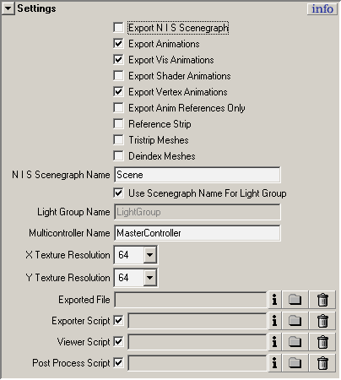
Pure3D UI Examples

Slide 40
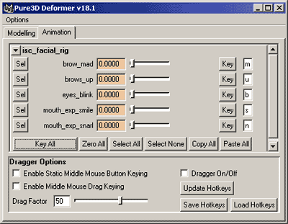
Pure3D UI Examples

Slide 41
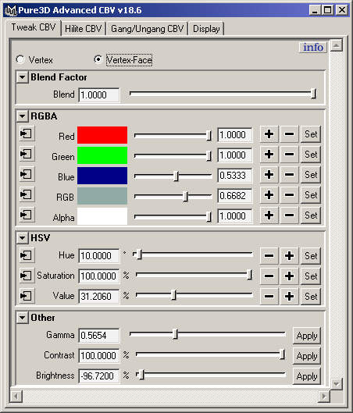
Pure3D UI Examples

Slide 42
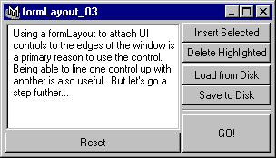
Building Your UI: Layouts
Learn to use the formLayout!
http://ewertb.com/maya/mel/formLayout

Slide 43
Defining a uiTemplate
uiTemplates allow you to specify spacing and alignment without typing the same thing over and over and over and over…
// Create a uiTemplate
uiTemplate myUITemplate;
// Define uiTemplate for controls
frameLayout –defineTemplate myUITemplate
-marginWidth 4 -marginHeight 4;
checkBoxGrp –defineTemplate myUITemplate
-columnAlign2 "right" "left"
-columnWidth2 48 128;

Slide 44
Using a uiTemplate
uiTemplates are "pushed" and "popped"
// "Push" the desired uiTemplate
setUITemplate -pushTemplate myUITemplate;
// Define uiTemplate for controls
frameLayout -label "The Frame";
checkBoxGrp -numberOfCheckBoxes 2
-label "Two Checks"
-labelArray2 "First" "Second";
// "Pop" the uiTemplate
setUITemplate -popTemplate;

Slide 45
MEL: Commands To Remember
fromNativePath & toNativePath
Converts between NT and UNIX filespecs.
optionVar
Stores values in user's preferences.
tokenize
Splits a string using the specified delimiter.
waitCursor
Tells the user when your script is busy.

Slide 46
Summary
MEL has a C-like syntax, but it ain't C.
Not as handy as the SDK's iterators, but MEL can traverse DAG/DG easily.
Sometimes it's necessary to replace Maya's MEL scripts.
Use callbacks to provide context to UI.
Commands that operate on a selection list can also filter a string array.

Slide 47
MEL In Print
Complete Maya Programming:
An Extensive Guide to MEL and the C++ API
by David Gould
Morgan Kaufmann Publishers
ISBN 1-55860-835-4
MEL Scripting for Maya Animators
by Mark R. Wilkins & Chris Kazmier
Morgan Kaufmann Publishers
ISBN: 1-55860-841-9
Both Available December 2002

Slide 48
Comments?
Email:
Bryan Ewert: bewert@radical.ca

